Slide 1
The ethical dilemma: how to represent Chilean schools in my research?
Dr Bernardita Munoz-Chereau
ESRC Research Fellow
GSoE, 07/03/17

Slide 2
Overview
Context of the Chilean school system
PhD thesis aims and methodology
Ethical dilemma in context

Slide 3
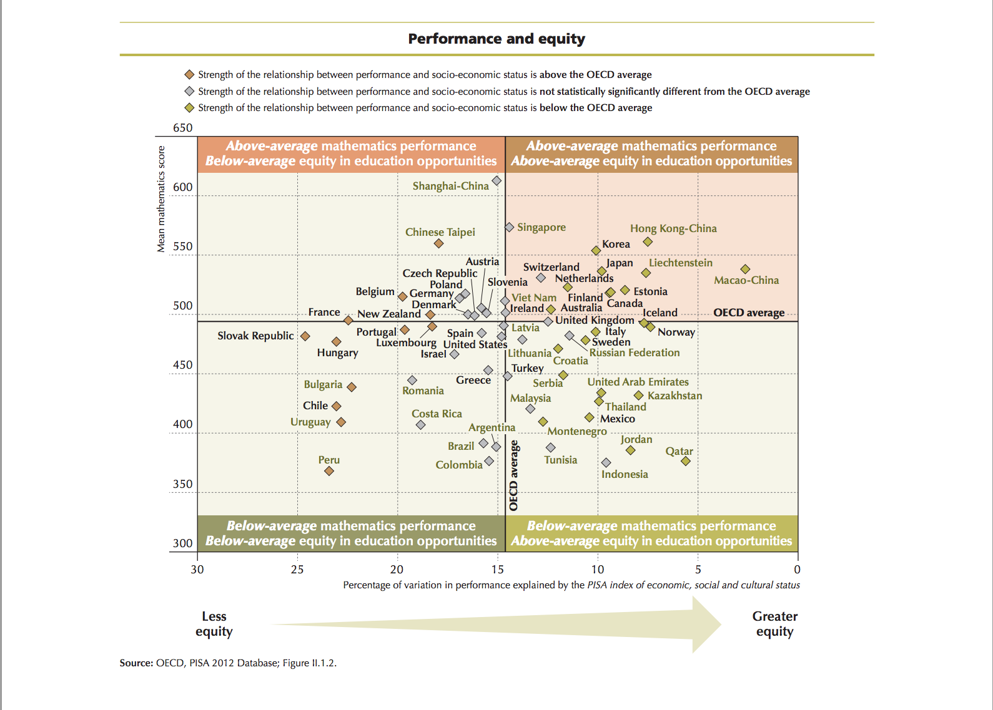

Slide 4
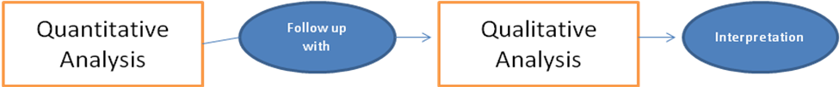
phd thesis aim and methodology
Aim: Compare Chilean school performance in a fair way
Methodology: Sequential Explanatory Mixed Methods design (Teddlie and Tashakkori, 2009; Creswell, 2009)
The main features of the data were:
Language (Spanish) National exam scores dataset (SIMCE)
Sample of 176,896 students (level-1) nested within 2,283 schools (level-2)
Response variable is an exam score took in secondary education : SIMCE year 10 in 2006
Key covariates at the student level: Language SIMCE year 8 (2004), Mother’s education, Family income, Student gender, Number of books at home
Key covariates at the school level: School SES, Mean prior achievement

Slide 5
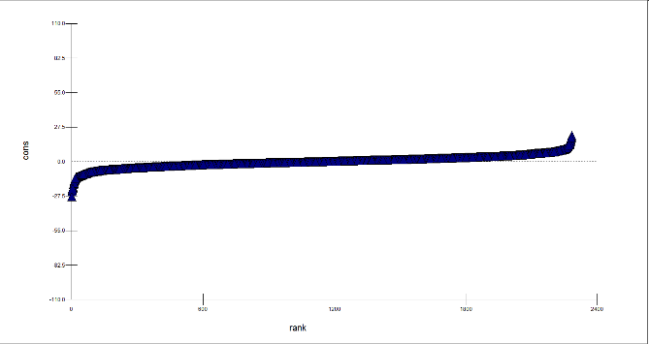
Phases of the study
First phase: quantitative
Investigate the range, extent and consistency of school effectiveness in Chilean secondary schools. the longitudinal sample was analysed using multilevel modelling (Goldstein,1995) in order to find an optimal model as a screening instrument to choose two schools.
Explore schools and classrooms’ processes and practices that worked as plausible explanations for the differences between one school that added value (A) in Language and one that did not (B).
School A
School B
second phase: qualitative

Slide 6
Instrumental case study schools (Stake, 1995)
School A
School B
Public school
Private-public school
Secondary school (y7 to y12)
Primary and secondary
Urban, RM
Urban, RM
Girls and boys
Girls and boys
Middle size: 800 students
Middle size: 960 students

Slide 7
Instrumental case study (cont)
Participants
Data collection techniques
2 schools
Document Analysis
2 Head teachers (1 each school)
Semi-structured Interviews
2 Jefes UTP (1 each school)
Semi-structured Interviews
Language teachers (1 each school)
Semi-structured Interviews
10 classrooms (5 each school)
Classroom observations and field notes

Slide 8
I found differences between schools A and School B in the expected direction (i.e achievement orientation, educational leadership, school climate as orderly atmosphere, etc.)
I found problematic aspects in school A: they had reduced teaching only to the assessed areas neglecting arts, PE, etc... was the school ‘adding value’ because it was playing the assessment game or because of their effective practices? What was school A effective for?
I found unexpected issues in school B: the language teacher I observed was new, as the previous one had retired after a long battle against cancer… how did the previous teacher’s health impact on the effectiveness of the school?
Main results

Slide 9
Pat Sikes (2010) reflects about the ethics of writing life histories and narratives in educational research, but I think the issues she raises are applicable to educational research as a whole.
She describes ethical writing as : ‘how would I feel if I, members of my family or my fiends were to be involved and treated and written about in the way the research in question involves or treats or depicts its participants?’ (p.14)
There are no simple solutions, but The most important ethical concern is to do all that we can to ensure that we re-present lives/institutions/schools respectfully.
Acknowledging the ethical dilemmas through our own research and writing is essential for ethical practice. how I describe schools, is how they appear to be
Ethical dilemma: how we represent
my participants

Slide 10
My ethical dilemma: context matters
high-stake assessment system under implementation in chile- policy-makers searching for ‘the’ best model. The question was: is CVA a useful tool to identify school quality?
Yes: CVA is a more meaningful measure of school effectiveness than Raw scores, due to the fact that it works as a handicap: levelling the playing field, but it also highlighted its limitations ( i.e based on previous performance)
No: unintended consequences or perverse incentives. As long as only academic achievement in limited curricular areas are considered in the Chilean national assessment system, schools will be concerned mainly with a narrow approach to what is taught and learned.
no on its own: no single indicator should be the sole basis for high-stakes decisions (National Research Council, 1999, in Braun et al, 2010).

Slide 11
My ethical dilemma: context matters (Cont)
Schools are much more complex than the categories I was using to describe them!
Keeping confidentiality… even against the pressures from policy-makers and participants
Understanding effectiveness as a necessary prerequisite for any definition of a ‘good’ school, but still narrow to describe quality.
Highlight methodological limitations: Avoid causal attributions in non-experimental fields-neither the methods independently applied, nor both of them together, provided causal explanations of the differences found in students’ performance.

Slide 12
References
Sikes, p. (2010) The ethics of writing life histories and narratives in educational research. In A. Bath-maker & P. Harnett (eds.) Exploring Learning, Identity and Power Through Life History and Narrative Research. pp. 11–24. London: Routledge/Falmer

